Slide 1
Week 1
Week 1 – key concepts and JS commands
Week 1
Learning to talk to Betty

Slide 2
Data types
Variables
Temporarily remembering things and reusing them
Primitive
Composite
Numbers
Strings ""
Using data
Logical operators
Mathematical operators
var = nameOfVariable
Controlling the flow of the script
Conditionals - if, else if, else
Loops
Doing things and reusing the steps;
Functions
Declaring
Dealing with data sets
Arrays - ordered data sets. Starts counting at zero
Objects - unordered data sets
Calling it
Ending it

Slide 3
Functions
Declaring
Calling it
Ending it
RETURN STATEMENTS - will leave function as soon as it sees a return
var makeSilentNoise = function () { console.log( "Making 'noise'" ); };
functionName ( );
Function Name(value of variable);

Slide 4
Controlling the flow of the script (JS)
Conditionals - if, else if, else
Loops
Start; Finish; How to calculate the finish
for (start; end; step) { // Statements to execute }
for (var countI = 0; countI <= 10; countI += 1) { console. Log( countI ); }
Betty - let me out!
for (var countI = 0; countI < 100; i++) { console.log( countI ); if ( countI === 7 ) { break; } }
Ordinary flow
Right to left
Top to bottom
jQuery
arrayName.each
This will enable you to run a function throug EACH element in the array

Slide 5
Declare it
for ( var counter = 0; i < array.Name.length; i++ ) { var fruit = fruits[ i ]; console.log( fruit ); }
Arrays
var emptyArray = []; separate items by comma;
Loop through an array
var newFruits = fruits.slice(); // Copy everything var twoFruits = fruits.slice( 1, 3 ); // Copy from index 1 to index 3
copy everything
arrayName.indexOf ("the word or item");
arrayName.includes ("word of item");
find something
var bananaIndex = fruits.indexOf( "Banana" ); fruits.splice( bananaIndex, 1 );
from a particular spot
arranyName.pop ();
at end
arraName.shift ();
at start
Removing elements
at a particular spot
arranyName.Push (“newelement”);
at end -
arrayName.unshift ("newelements");
at start
Adding elements
arrayName[0] = "Indigo";
Changing value of array -
Access an array - arrayName [indxnumber];

Slide 6
What I say | What Betty does
Console.log (arrayName) | Lists all the items in the array in square brackets
Console.log (arrayName.length) | Tell me how many things are in the array
arrayName [0] | Tell me what’s the first element in the array
arrayName.indexOf (“element name"); | Tell me what the position if - in numbers – of this particular item
ArrayName.reverse | Changes the order of the array so that it is backwards

Slide 7
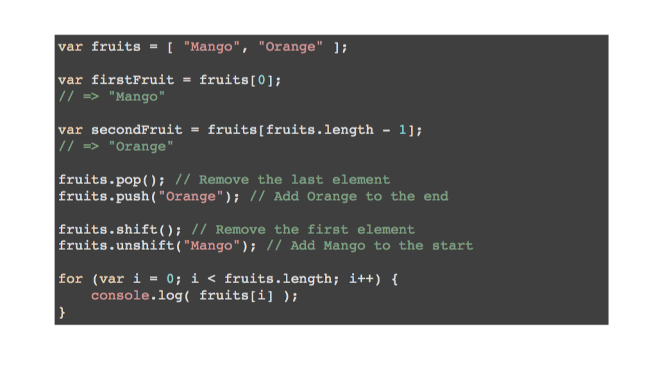

Slide 8
Objects
Access things in it
Find if something is in it
Removing things
Copy it
Declare it
var emptyObject = {key:value; key.value}; - the stuff inside the brackets is called the property
USE THE DOT objectName.property
Eg var movieName = movie.name; var movieDirector = movie.director; var movieDuration = movie.duration;
var movieName = movie["name"]; var movieDirector = movie["director"]; var movieDuration = movie["duration"];
movie["gobbledygook"]; // => undefined
var bestCamera = { brand: "Leica", model: "M3", year: 1955, memoryCard: "SD" }; delete bestCamera.memoryCard;
delete objectName.propertyToDelete
eg var movie = { name: "Satantango", director: "Bella Tarr", duration: 432 };
Updating things in it
DOT NOTATION objectName.propertyName = "newValues" var movie = { name: "Satantango", director: "Bela Tarr", duration: 432 }; movie.name = "Sátántangó"; movie.director = "Béla Tarr";
Loop through it
var movie = { name: "Satantango", director: "Bela Tarr", duration: 432 }; for ( var key in movie ) { console.log( key + ": " + movie[key] ); }
eg var movieKeys = Object.keys( movie ); // => ["name", "director", "duration"]
What’s the difference between these two
Can nest objects
Can put methods in objects

Slide 9
THIS ??????

Slide 11
Var $newArray = $ (“element from the DOM ie the tree”)
Can then use $newArray in any way you would use an ordinary array – plus other clever jQuery
jQuery
Magic
When use a jQuery function, it creates an array

